Slide 1

AI/ML SOS IDK
posit::conf(2026)
Kathryn Cronquist and Olivia Hebner
September 14, 2026

Slide 2

Disclaimer(s)
The views expressed in this presentation are solely those of the presenters and do not represent the views of Summit Consulting, LLC, the National Women’s Soccer League (NWSL), or the Washington Spirit. This presentation is not affiliated with, sponsored by, or endorsed by the NWSL or the Washington Spirit.
We’re data scientists and passionate fans, not soccer experts. Our soccer credentials include cheering loudly, blindly questioning the referee, and always believing in our team. Please direct any complaints about our predictions to the random forest. Go Spirit!

Slide 3
So…you want to try machine learning?
Notes:
We have good news and we have bad news…bad news first

Slide 4
tidymodels • scikit-learn • TensorFlow • PyTorch • XGBoost • random forest • neural networks • MLflow • recipes • parsnip • workflows • tuning • cross-validation • hyperparameters • feature engineering • MLOps • LLMs • embeddings • transformers • WHAT IS A PARSNIP • tidymodels • scikit-learn • TensorFlow • PyTorch • XGBoost • random forest • neural networks • MLflow • recipes • parsnip • workflows • tuning • cross-validation • hyperparameters • feature engineering • MLOps • LLMs • embeddings • transformers • WHAT IS A PARSNIP • tidymodels • scikit-learn • TensorFlow • PyTorch • XGBoost • random forest • neural networks • MLflow • recipes • parsnip • workflows • tuning • cross-validation • hyperparameters • feature engineering • MLOps • LLMs • embeddings • transformers • WHAT IS A PARSNIP • tidymodels • scikit-learn • TensorFlow • PyTorch • XGBoost • random forest • neural networks • MLflow • recipes • parsnip • workflows • tuning • cross-validation • hyperparameters • feature engineering • MLOps • LLMs • embeddings • transformers • WHAT IS A PARSNIP • tidymodels • scikit-learn • TensorFlow • PyTorch • XGBoost • random forest • neural networks • MLflow • recipes • parsnip • workflows • tuning • cross-validation • hyperparameters • feature engineering • MLOps • LLMs • embeddings • transformers • WHAT IS A PARSNIP • tidymodels • scikit-learn • TensorFlow • PyTorch • XGBoost • random forest • neural networks • MLflow • recipes • parsnip • workflows • tuning • cross-validation • hyperparameters • feature engineering • MLOps • LLMs • embeddings • transformers • WHAT IS A PARSNIP • tidymodels • scikit-learn • TensorFlow • PyTorch • XGBoost • random forest • neural networks • MLflow • recipes • parsnip • workflows • tuning • cross-validation • hyperparameters • feature engineering • MLOps • LLMs • embeddings • transformers • WHAT IS A PARSNIP • tidymodels • scikit-learn • TensorFlow • PyTorch • XGBoost • random forest • neural networks • MLflow • recipes • parsnip • workflows • tuning • cross-validation • hyperparameters • feature engineering • MLOps • LLMs • embeddings • transformers • WHAT IS A PARSNIP • tidymodels • scikit-learn • TensorFlow • PyTorch • XGBoost • random forest • neural networks • MLflow • recipes • parsnip • workflows • tuning • cross-validation • hyperparameters • feature engineering • MLOps • LLMs • embeddings • transformers • WHAT IS A PARSNIP • • tidymodels • scikit-learn • TensorFlow • PyTorch • XGBoost • random forest • neural networks • MLflow • recipes • parsnip • workflows • tuning • cross-validation • hyperparameters • feature engineering • MLOps • LLMs
Notes:
The bad news is that machine learning has approximately eight million packages, frameworks, algorithms, acronyms, and opinions about how you’re supposed to do it

Slide 5
Be boring!
Notes:
The good news? Your first machine learning workflow can be incredibly boring. And we think it should be. In this session, we’ll show you how to start with one manageable, reproducible workflow that can easily be expanded once you understand the basics.

Slide 6
Purpose
Build one complete machine learning workflow in R
We’ll use tidymodels and a random forest to make a prediction from start to finish
Split → Preprocess → Specify → Fit → Evaluate

Slide 7
Will the Washington Spirit make the 2026 playoffs?
Notes:
And while we said you should start “boring” with your techniques, you don’t have to start with boring questions/predictions.

Slide 8
Our very not boring prediction!
Partway through a season, will this team make the playoffs?
One row
Inputs
Outcome
One team at one point in one season
Performance and context available at that time
Eventually made the playoffs (Yes/No)
Notes:
Say: “We reconstruct what teams looked like partway through earlier seasons, then attach whether they eventually qualified. Our test is whether that helps us predict a season the model hasn’t seen.”

Slide 9
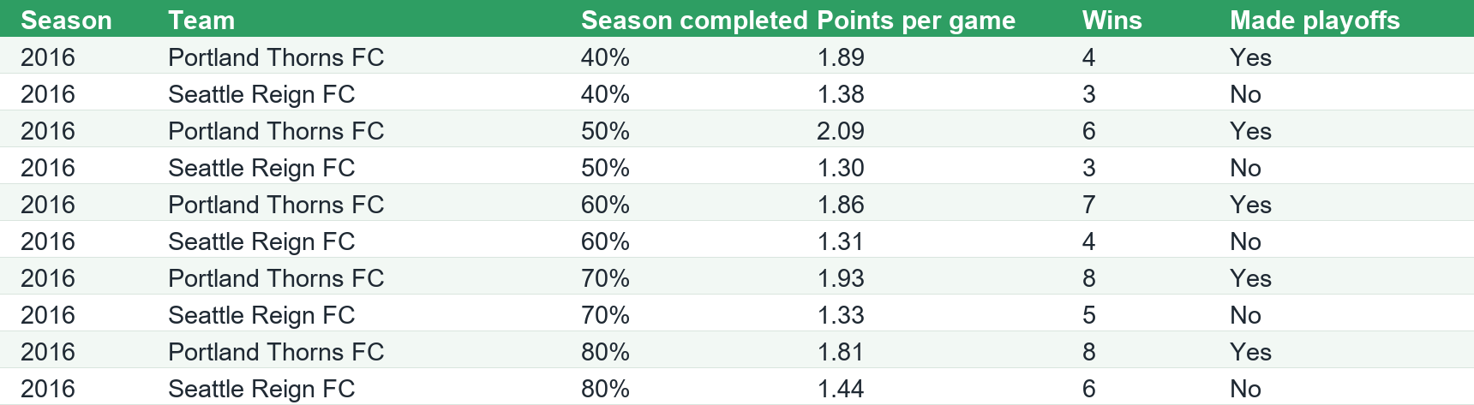
Our very not boring prediction!

Slide 10
You already know more than you think.
lm(y ~ x1 + x2, data = training_data)
Outcome + predictors + a model
y
OUTCOME
What we’re predicting
x1 + x2
PREDICTORS
The inputs we use
training_data
DATA
What we learn from
Notes:
Before we introduce the “boring” ML framework….
Say: “If you’re comfortable with regression, you already know the most important modeling questions. What are we predicting? Which predictors make sense? What observations will the model learn from?
Today our outcome is whether a team eventually makes the playoffs. Our predictors describe how the team was performing at a specific point in the season, and our training data comes from prior NWSL seasons. The algorithm changes, but those underlying decisions don’t disappear. Tidymodels gives us a consistent structure for handling them.”
“Your statistical thinking still matters. We still need a clear outcome, sensible predictors, and an honest way to check performance. Tidymodels gives us a consistent structure around those decisions.”

Slide 11
The whole workflow on just one slide!
Split
Preprocess
Specify
Fit
Evaluate
Notes:
Say: “We split the data, define the preprocessing, specify a model, fit it, and evaluate it. Those five steps are our map. We’ll use a workflow to connect the pieces and practice on earlier seasons before the final test. Then we can answer our original question.”
One sentence about tools: “RStudio is where we’re working; tidymodels is the collection of R packages doing these jobs.”
Technical note: Recipe and model specifications are instructions, not fitted objects. Learned preprocessing happens within each training fit. Resampling evaluates the assembled workflow; it is not a one-time data transformation to run before model specification. Workflow resampling documentation

Slide 12
Preventing data leakage
Split
Preprocess
Specify
Fit
Evaluate
Prediction date: 60% complete
Season begins
Season ends
AVAILABLE AT THE PREDICTION DATE
NOT AVAILABLE YET
Points per game to date
Goal difference to date
Points from the last five matches
Current playoff cutline gap
Results of later matches
Final points or final rank
End-of-season statistics
Final playoff position
Use the final playoff result as the historical outcome, never as a predictor.
Notes:
Second quick example: Two snapshots of the same team-season accidentally placed in training and testing.
Say: “The model can look brilliant if we give it answers from the future—or test it on a near-duplicate of what it already learned from.”
Notes: The eventual playoff result is correctly used as the historical outcome label; it must not be supplied as a predictor. Learned preprocessing, such as an imputation median, must also be estimated without using test or current-season rows.

Slide 13
The test set goes away now!
Split
Preprocess
Specify
Fit
Evaluate
Develop the model
2016–2024
excluding 2020
Final test
2025
set aside — returns later
Current prediction
2026
what we forecast
Notes:
Say: “We use earlier seasons to develop the model. We save 2025 for the final test. The current season has no outcome labels yet.”
Notes: Do not substitute a random row split. Excluding 2020 preserves a comparable regular-season/playoff outcome; COVID replaced that season with different competitions. The rule is to split before learning preprocessing or making data-driven modeling choices, not to prohibit inspecting column names or defining the prediction problem first.

Slide 14
A recipe records how inputs should be prepared
Split
Preprocess
Specify
Fit
Evaluate
playoff_recipe <- recipe(
made_playoffs ~
points + wins + goal_diff + games_played +
last_5_points + last_5_goal_diff +
points_rank_pct + points_gap_to_cutline +
playoff_share + season_pct,
data = train
) |>
step_mutate(
points_per_game = points / games_played,
win_pct = wins / games_played,
goal_diff_per_game = goal_diff / games_played
)
Performance
points, wins, goal_diff, games_played
+ derived: points_per_game, win_pct, goal_diff_per_game
Momentum
last_5_points, last_5_goal_diff
Context
points_rank_pct, points_gap_to_cutline, playoff_share, season_pct
Notes:
Say: “This is where we tell tidymodels what columns are eligible and how to transform them before the model ever sees the data. The important part is that the same preparation happens later for the test data and 2026 data automatically.”
Also mention: “Then we remove the raw totals and drop any predictors with no variation.” (step_rm() and step_zv(), left off the slide for space.)
Say: “The recipe describes the prep. When we fit the workflow, it learns any required values from that fit’s training data and applies the same rules to new data.”
Keep the example honest: The prepared data have no missing predictor values. If showing median imputation, call it a guard for future missing inputs; do not claim it cleaned missing values in this extract. The nine selected predictors are numeric, so dummy encoding is unnecessary. Ranger also supports categorical predictors without requiring dummy variables. Scaling is unnecessary for this example. Ranger preprocessing guidance
Brief mention only: Other models may need normalization, encoding, or transformations. Do not add those steps merely to demonstrate more functions.

Slide 15
What even is a random forest?
Split
Preprocess
Specify
Fit
Evaluate
Random sample 1
Random sample 2
Random sample 3
Goal diff > 0?
Season wins ≥ 12?
Points per game ≤ 1?
Playoffs
Playoffs
No Playoffs
Win + Win + Loss → votes averaged → Prediction: WIN
Notes:
Say: “A single tree learns decision rules. A forest grows many trees using different samples and predictor subsets, then combines their predictions. That lets it capture nonlinear patterns and interactions without our specifying every one.”
Why today: It is a practical model for demonstrating this workflow and requires little preprocessing here. This does not establish that it is the best model for NWSL forecasts.
Technical note: For the probability forest used by parsnip/ranger, describe combining or averaging tree-level probability estimates; do not define the displayed score as the percentage of trees casting a hard Yes vote. Random forest specification, ranger engine details

Slide 16
Tell R what you want with parsnip
Split
Preprocess
Specify
Fit
Evaluate
rand_forest(trees = 500) |>
set_engine("ranger") |>
set_mode("classification")
rand_forest()
MODEL
The algorithm we choose
"ranger"
ENGINE
Which implementation runs it
"classification"
MODE
Predicting a category, not a number
Notes:
Say: “Random forest is the model. Ranger is the implementation. Classification is the task. We’ve specified what we want; we haven’t fitted it yet.”
Notes: These are the fixed settings in the prepared starter script. They are teaching settings, not tuned or optimal settings. Parsnip introduction

Slide 17
Put the pieces together with workflows
Split
Preprocess
Specify
Fit
Evaluate
playoff_recipe
How do we prepare the data?
+
rf_spec
What model do we want?
playoff_workflow
One object, ready to fit
playoff_workflow <- workflow() |>
add_recipe(playoff_recipe) |>
add_model(rf_spec)
Notes:
Say: “Now our prep and model travel together. That means each fit can learn the prep using only its own training data, and new observations get the same preparation.”
Demo choice: Run this short block in RStudio or show its prepared output. Keep the full script available through a clickable link. The expensive repeated fitting should already have saved output available.

Slide 18
Train on the past. Test on the future.
Split
Preprocess
Specify
Fit
Evaluate
TRAIN
2016
2017
2018
2019
2020
excluded
2021
2022
2023
2024
TEST
2025
HELD OUT
FIT MODEL

Slide 19
The test set returns!
Split
Preprocess
Specify
Fit
Evaluate
OPEN
CHOICES FIXED
trees = 500
engine: ranger
mode: classification
FIT ON ALL
DEV SEASONS
2016–2024
excluding 2020
Final test
2025
set aside — returns later
Opened now — scored once.
Notes:
Say: “With our choices fixed, we fit once using all the development seasons. Then we bring back 2025 for the final evaluation.”
Notes: Preserve the existing script’s fit-then-predict pattern. A properly constructed rsample split could alternatively support last_fit(), which fits the training set and evaluates its test set. Do not show both approaches on the main slide. Do not revise settings after seeing the final test and still describe that result as untouched. last_fit() documentation

Slide 20
Time to fit.
Split
Preprocess
Specify
Fit
Evaluate
playoff_fit <- playoff_workflow |>
fit(data = train)
That’s it. The workflow learns from 2016–2024.
Recipe applied → random forest trained → 2025 remains untouched

Slide 21
Could we have predicted last season?
Split
Preprocess
Specify
Fit
Evaluate
2025 · 60% of the season · 14 teams · never seen during training
test_predictions <- predict(
playoff_fit,
new_data = test_60
)
What the model predicted vs. what happened
Actually made playoffs
Actually missed playoffs
Predicted playoffs
8 ✓
0
0 false alarms
14 / 14 correct
Predicted no playoffs
0
0 missed playoff teams
6 ✓
Yes, that says 100%. No, we have not solved soccer.
One season. One checkpoint. 14 teams. A successful test case, not a perfect model.
Notes:
Say: “Now we can compare our predictions with what actually happened. Which teams did we call correctly? Where did we get it wrong?”
The relevant evaluation pitfall: At this checkpoint, one changed classification moves accuracy by about 7 percentage points. The 70 rows across five checkpoints are still only 14 team outcomes. Do not present them as 70 independent test cases.
Notes: Choose the 70% checkpoint before looking for the best result. Do not force an “accuracy can lie because of class imbalance” lesson if imbalance is not the main issue. Use the next slide to show why a comparison baseline matters.

Slide 22
Did the forest beat the 2025 standings?
Split
Preprocess
Specify
Fit
Evaluate
Team | Actual | Predicted | RF playoff score
Kansas City Current | Yes | Yes | 100%
San Diego Wave FC | Yes | Yes | 99%
Orlando Pride | Yes | Yes | 98%
Portland Thorns FC | Yes | Yes | 96%
Washington Spirit | Yes | Yes | 96%
Racing Louisville FC | Yes | Yes | 88%
Seattle Reign FC | Yes | Yes | 86%
Gotham FC | Yes | Yes | 53%
North Carolina Courage | No | No | 31%
Houston Dash | No | No | 17%
Angel City FC | No | No | 7%
Bay FC | No | No | 7%
Chicago Stars FC | No | No | 0%
Utah Royals | No | No | 0%

Slide 23
Refit the approved workflow for the 2026 prediction
Split
Preprocess
Specify
Fit
Evaluate
Once evaluation is complete, every completed season can help train the prediction model.
FINAL EVALUATION
2026 PREDICTION
Fit: 2016–2024
Test: 2025
Refit: 2016–2025
Predict: 2026
The recipe, predictors, and random forest specification remain unchanged.

Slide 24
The 2026 prediction data
Split
Preprocess
Specify
Fit
Evaluate
The 2026 rows contain the same predictors at the same season checkpoint, but the outcome is still unknown.
team | season_pct | points_per_game | goal_diff_per_game | made_playoffs
Washington Spirit | 60% | 1.89 | 0.63 | ?
Gotham FC | 60% | 2.11 | 0.63 | ?
San Diego Wave FC | 60% | 1.68 | 0.21 | ?
Portland Thorns FC | 60% | 1.55 | 0.17 | ?
+ additional teams and current-season statistics
These are model scores, not calibrated playoff odds.
We cannot evaluate the 2026 predictions until the season ends.

Slide 25
So…will the Spirit make the playoffs?
WASHINGTON SPIRIT
99%
RF PLAYOFF SCORE
0%
50%
↑ playoff threshold
100%
The model is very strongly Team Playoffs for Washington.
Based on the 2026 season to date
Model score, not a 99% real-world probability of making the playoffs.

Slide 26
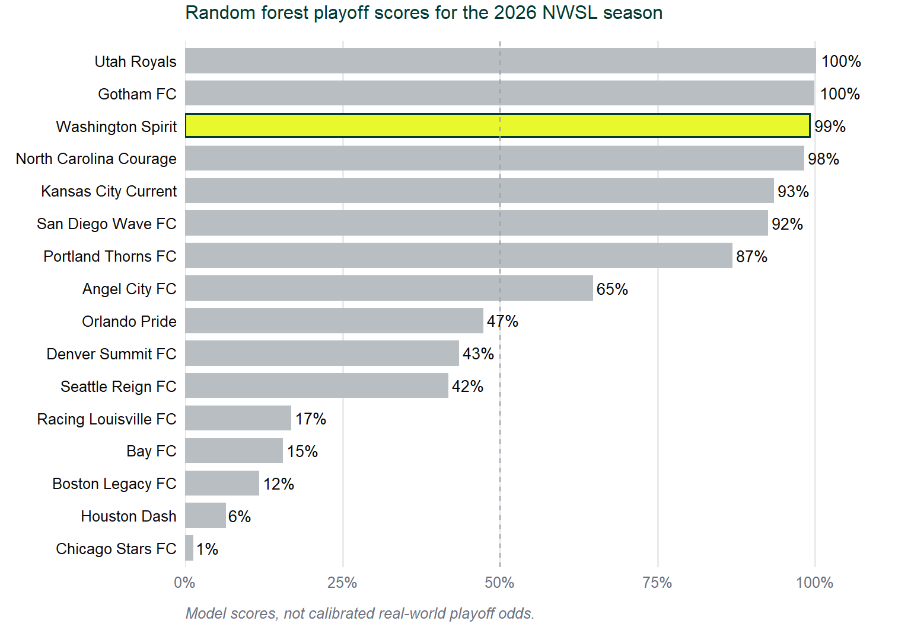

Slide 27
Now you know where to start.
Split
›
Preprocess
›
Specify
›
Fit
›
Evaluate
Past vs. future
Clean & engineer
Random forest
Learn the pattern
Score & check
The workflow never changes—only the question does.
Reproduce the example
Code, prepared data, documentation, and references
github.com/summitllc/posit-ai-ml
Notes:
Say: “Tomorrow, pick a small prediction problem, start with a simple baseline, and follow the workflow. If machine learning in R feels a little more boring than it did when we started, we did our job.”
Callback: Optionally use a quick reveal from the opening word wall to the small set actually used: rsample, recipes, parsnip, workflows, tune, and yardstick. The tune package supports fit_resamples() even when no hyperparameter tuning is performed. Do not add another timed closing slide just for this reveal.

